Slide 1
Breakfast With The Chiefs:
Opportunities and Tensions in the Quality Agenda
Joshua Tepper MD, MPH, MBA
November 2013
@drjoshuatepper
Joshua.tepper@hqontario.ca

Slide 2
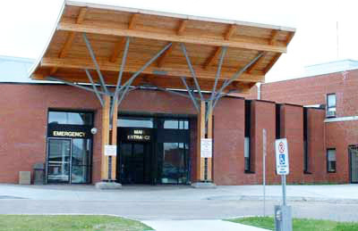

Slide 3

Hospital Specific CS Rates for Robson 1, 2a, 2b combined in Low Risk Women, Sorted in Ascending Order, 2007/08 – 2011/12
data source: BORN Ontario (hospitals with 0 c-sections or suppressed rates were excluded)
The cohort includes women aged 20-34 years with no maternal medical or obstetrical problems and without the following indications for CS: cord prolapse, diabetes, fetal anomaly, placental abruption, placenta previa, pre-eclampsia , other fetal or maternal health problems
1. Nulliparous, singleton, cephalic, term, spontaneous labour
2. Nulliparous, singleton, cephalic, term, induced labour or CS before labour
Notes:
1. Nulliparous, singleton, cephalic, term, spontaneous labour
2. Nulliparous, singleton, cephalic, term, induced labour or CS before labour
3.Multiparous, singleton, cephalic, term, without a previous CS, spontaneous labour
4.Multiparous, singleton, cephalic, term, without a previous uterine scar, induced labour or by CS before labour
5. Multiparous, singleton, cephalic, term, with a previous CS
6. Nulliparous, singleton, breech
7. Multiparous, singleton, breech
8. Multiple pregnancy (twins or higher-order multiples)
9. Singleton, transverse or oblique lie
10. Singleton, cephalic, pre-term

Slide 4


Slide 5


Health Quality Ontario
Notes:
About HQO, ECFAA our activities

Slide 6

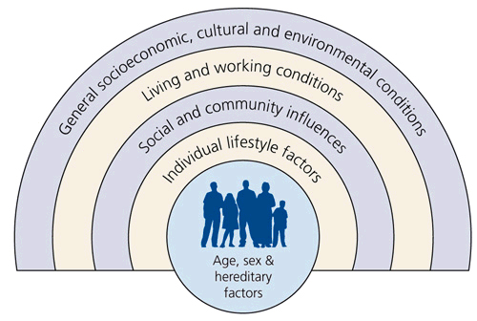




5 Critical Opportunities
Notes:
1)EHR – share across settings, pull data
2)System data is slow need alternatives
3)Social determinants…health in all policy
4)Involve the patient and the public- Peter Macleod
5)Coordination – we are large nonethe less the degree of fragmentation is disproproationally large relative to our size. Some of this is silo’s but a lot is just poor communication, structure leading to redundancy at best and diminished impact at worst. Need to seek collective Impact
6)Build a culture in health care committed to improvement, culture change towards a system that puts quality first needs to be deliberate exercise

Slide 7
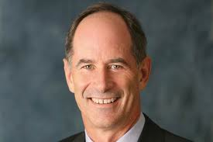
“The ability to face constructively the tension of opposing ideas and, instead of choosing one at the expense of the other, generate a creative resolution of the tension in the form of a new idea that contains elements of the opposing ideas but is superior to each” Roger Martin

Slide 8
Tensions in the Quality Discourse
QI
Rapid Cycle Evaluation
Reduce Variation
Innovation
Accountability
Research
Local Autonomy for local need
Scale & Spread
Barbara Starfield, Johns Hopkins University

Slide 9
Questions
What are the missing opportunities in the quality agenda in Ontario?
How do you differentiate between quality improvement and accountability for performance? What is the right balance for HQO and the system?
How can we make quality improvement plans (QIP) better?
What kind of data should HQO report publicly vs. privately?
What would success look like from a monitoring and reporting perspective?
What would a value-add partnership with HQO look like?

Slide 10
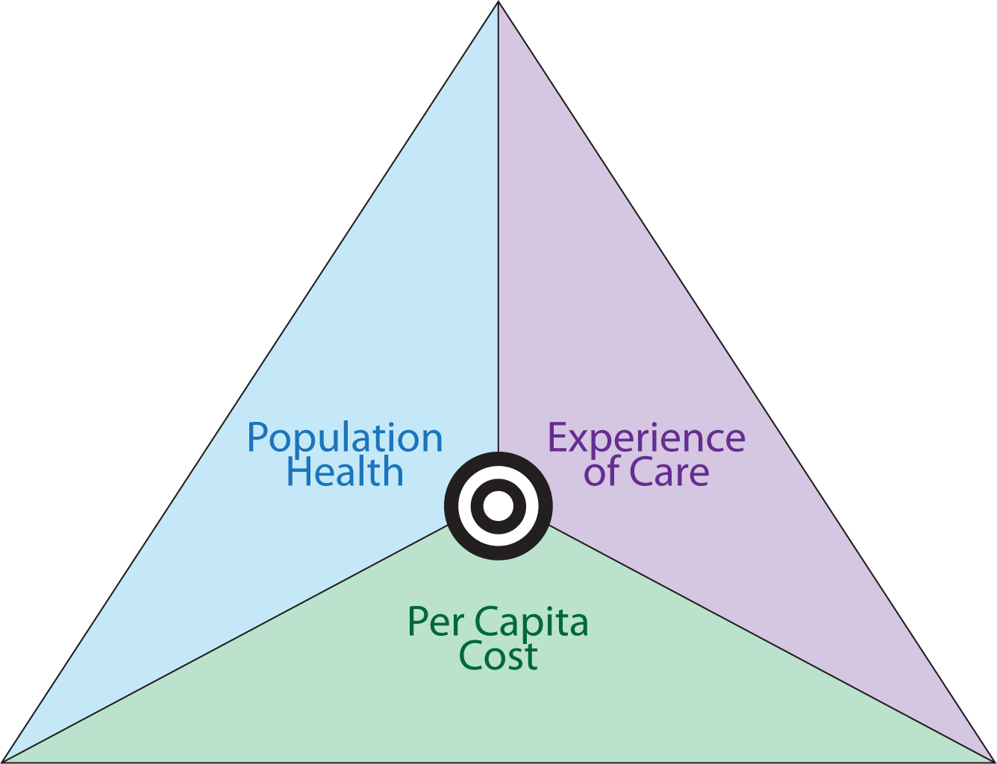

Slide 11
Thank You
@drjoshuatepper
Joshua.Tepper@hqontario.ca
Notes:
Thank you, seven weeks, main goal is to have a conversation and to learn.
1)Share my personal journey with HQO
2)About HQO
3)What my thoughts are about challenges
4)Explore some core dialectics

Slide 12
The Excellent Care for All Act, 2010
Provides new standards to ensure that Ontarians receive health care of the highest possible quality and value.
Aims to improve the quality of Ontario’s health care system and make sure funding is used to provide the best possible care, so that:
  The patient is at the centre of the health care system
  Decisions about care are based on the best evidence and standards
  The system is focused on quality of care and the best use of resources
  The main goal of the system is to get better and better at what it does

Slide 13
Health Quality Ontario
.
HQO’s legislated mandate under the Excellent Care for All Act, 2010 is to:
  Monitor and report to the people of Ontario on the quality of their health care system
  Support continuous quality improvement
  Promote health care that is supported by the best available scientific evidence
HQO is an arms-length agency of the Ontario government.

Slide 14
Provide the change
Drive change through innovation, spread and scale
Monitor and Report

Slide 15
Reflections at 60 days
EHR are a significant concern
The absence of patient and public lens

Slide 16
CS Rates for Robson 1, 2a in Low Risk Women by Hospital and Hospital Level of Care, 2007/08 – 2011/12
data source: BORN Ontario (hospitals with 0 c-sections or suppressed rates were excluded)
The cohort includes women aged 20-34 years with no maternal medical or obstetrical problems and without the following indications for CS: cord prolapse, diabetes, fetal anomaly, placental abruption, placenta previa, pre-eclampsia , other fetal or maternal health problems

Slide 17
CS Rates for Robson 1, in Low Risk Women by LHIN, 2007/08 – 2011/12
data source: BORN Ontario
The cohort includes women aged 20-34 years with no maternal medical or obstetrical problems and without the following indications for CS: cord prolapse, diabetes, fetal anomaly, placental abruption, placenta previa, pre-eclampsia , other fetal or maternal health problems
Notes:
Andre lalonde
1. Nulliparous, singleton, cephalic, term, spontaneous labour
2. Nulliparous, singleton, cephalic, term, induced labour or CS before labour
3.Multiparous, singleton, cephalic, term, without a previous CS, spontaneous labour
4.Multiparous, singleton, cephalic, term, without a previous uterine scar, induced labour or by CS before labour
5. Multiparous, singleton, cephalic, term, with a previous CS
6. Nulliparous, singleton, breech
7. Multiparous, singleton, breech
8. Multiple pregnancy (twins or higher-order multiples)
9. Singleton, transverse or oblique lie
10. Singleton, cephalic, pre-term

